Slide 1
Wrong&Correct
2015.10.20
Hanyang Information Inc.
By JISU.

Slide 2
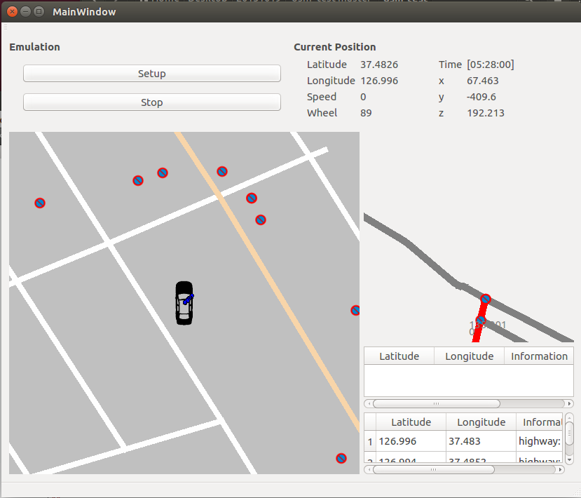
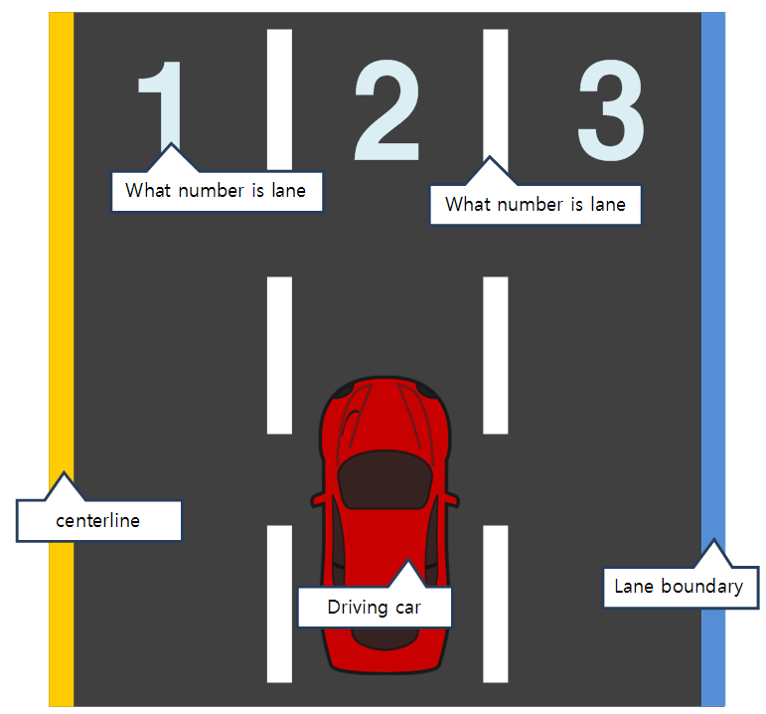
1. Wrong Part
Please change this part.
Like below image.

Slide 3
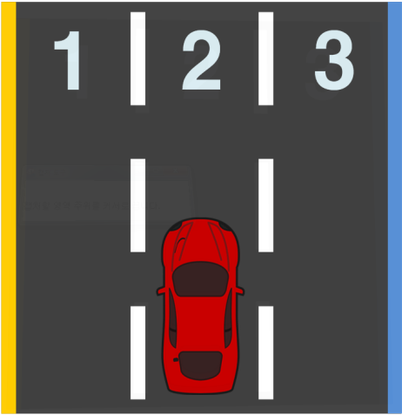
1. Correct Part
Please make a allow about direction of wheel.

Slide 4
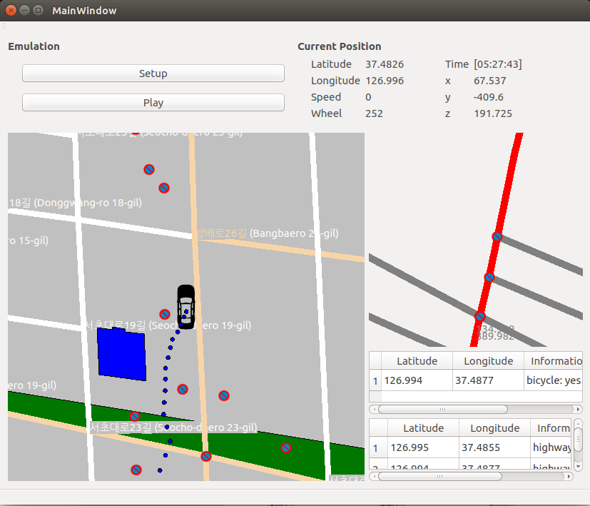
2. Wrong the map
Please configure the gps data.

Slide 5
2. Correct the map
Please express the car and tracking on the road.

Slide 6
3. Wrong the expansion of the map
Please extend the map

Slide 7
3. Correct the expansion of the map

Slide 8
4. Wrong traffic signals
Please express the traffic signal(driving data)
Like queue.

